Slide 1
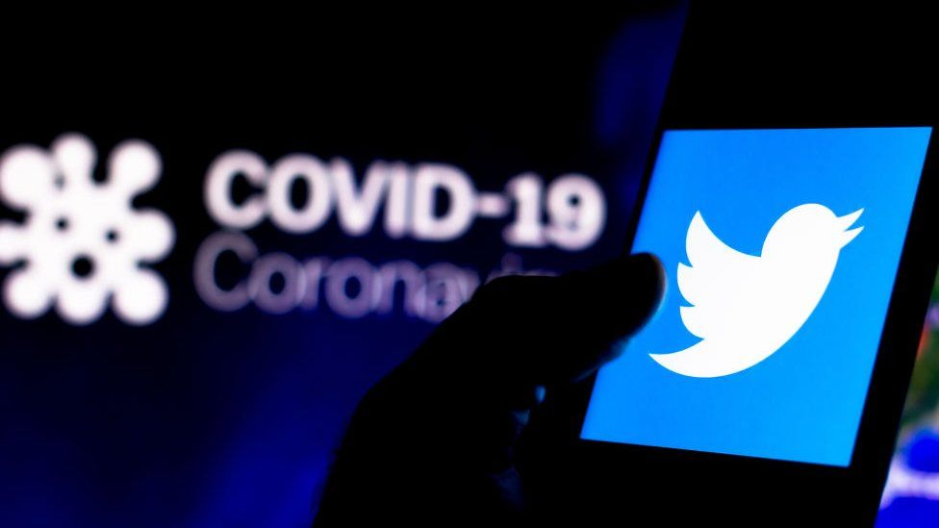
Covid-19 Impact on Twitter in North Carolina
Jimmy White Lauren Parrish
Mariam Ahmad Zehra Tokatli
Hector Ladero

Slide 2
This project is designed to identify the impact of Covid-19 on Twitter usage in the state of North Carolina. The team hypothesizes that twitter references to Covid-19 are positively correlated with the progression of the virus. Is that consistent with Twitter COVID-19 references in North Carolina. By leveraging data sources for both Twitter and COVID-19 19 the team plans to answer the following:

Slide 3
Questions to Ask?????
Are references to Covid-19 on Twitter positively correlated with the virus progression in North Carolina?
Does location impact the probability of Twitter use as the virus progressed?
As the number of cases and deaths increased, did Twitter original Tweets increase?
As the number of cases and deaths increased, did Twitter retweets increase?
Is North Carolina a good representation of US COVID-19 trends and what thereby can be inferred about Twitter usage?

Slide 4
Data Clean up and Exploration
The project will leverage two data sources pulled from the Twitter API and New York Times COVID-19 19 Data leveraged from Kaggle. The Team will focus on data in North Carolina from the March – May 2020 to make their assessments.
Challenges with pulling data from social media platforms
Code sample reflecting how data from Twitter was pulled and COVID-19 data sources.
Graphical comparisons answering questions posted by the project team.
Conclusions

Slide 5


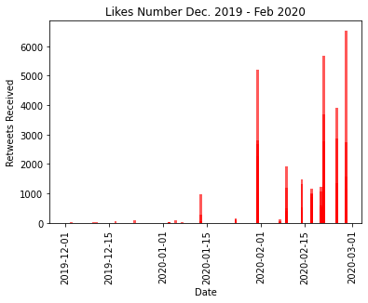


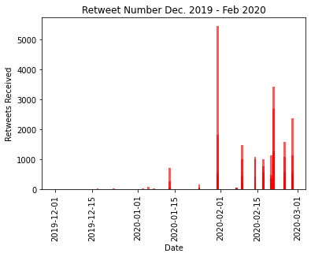

Data Analysis “Twitter”
Looking at the analysis, the group created a bar chart in reference to the amount of likes on Twitter from Dec 2019 to Feb 2020 as you can see there is an extreme spike up throughout the month of February. In the second chart where we analyzed rewets from Dec 2019-Feb 2020 there is a massive increase but then gradually decreases throughout the month. We can see a correlation with the news about Covid-19 and Twitter usage.

Slide 6
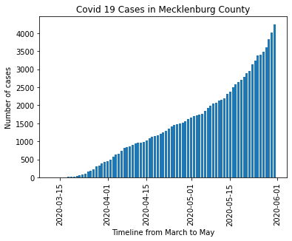
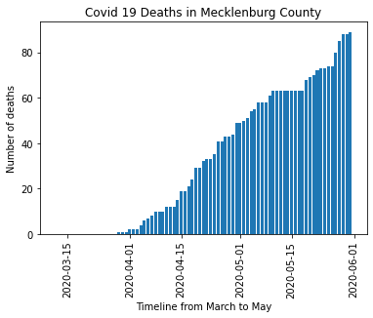
Data Analysis COVID-19 Cases in “Mecklenburg”
Looking at this Data Analysis we look at the COVID-19 cases in Mecklenburg county drastically in creases from April to June 2020. As the news was coming out and people were getting sick hospitals were getting people that were infected with COVID-19 it was like a tidal wave that hit. When we also look at the death rates from April to June there was such a massive increase as the chart indicates.

Slide 7
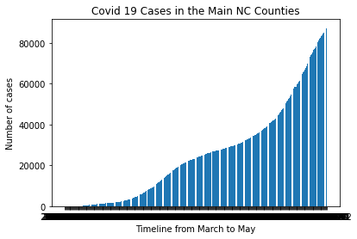
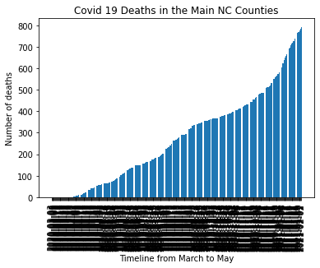
Data Analysis of counties in NC
This Analysis focused in on the counties in NC showing COVID-19 cases massively increases and as well as deaths in many parts of the counties it was just so massive once the world recognized what we were up against people were checking themselves into hospitals to see if they contracted the virus and with the data pull it clearly indicates a massive increase in those months.

Slide 8
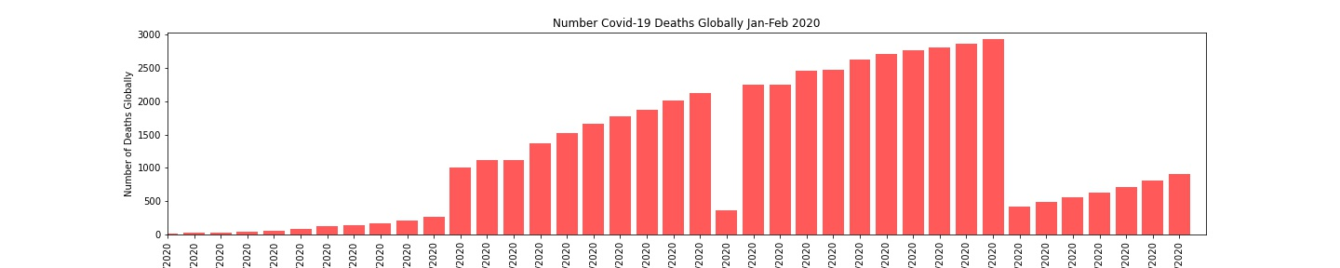
Covid-19 Deaths Globally
This analysis shows the number of deaths globally during the time frame you can see a huge hike since the virus became public people were more aware of what was happening, and the cause of death was. Social media played a big part of informing the

Slide 9
Covid-19 Analysis
Observation 1: The virus was first identified in China in December 2020. There is little Twitter noise worldwide during December. This does not appear unusual as there was little transparency about the virus in the initial phase of the virus nor is China particularly known for being particularly forthcoming with such information.
Observation 2: The team hypothesized that original tweets, likes, and retweets would increase steadily with the progression of the virus. This isn’t what the data set reflected. Original tweets occurred on days when there was major world headlines. The clear instance of this is on January 31st when the US announced travel restrictions for those who had been to China and the first quarantines. Similar large announcements occurred on February 9th, 2020 when the Chinese stated that they would invest 10bn to fight the virus and on February 21st when the WHO announced that Covid-19 was officially a pandemic.
Observation 3: Tweet “Likes” and “Retweets” differed slightly. There were still peaks on days which correlated to major headlines, but as the virus progressed there “Likes” and “Retweets” reflected more stable forward progression as was expected. Also, the comparison between “Likes” and “Retweets” reflects that Twitter users are more inclined to like rather than retweet.

Slide 10
Conclusion
News cycles have significant impact on original tweets rather than sustained but increasing information such as what was experienced in the early part of the Covid-19 pandemic.
As awareness of a topic, like Covid-19, grows, Twitter users are more likely to be involved in that topic. This corresponds to more tweet “Likes” and “Retweets.”

